Slide 1

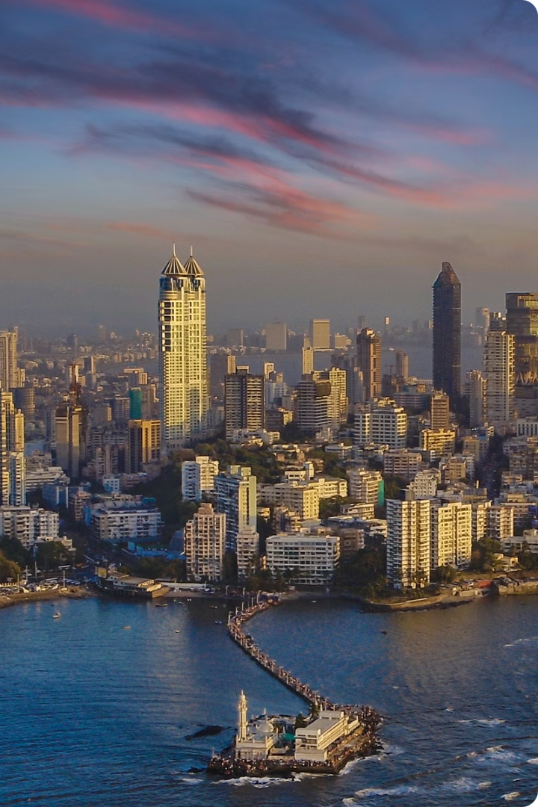
Reducing Road Congestion in Greater Mumbai
Greater Mumbai faces significant challenges with road congestion, affecting daily commutes, economic productivity, and air quality. This report explores various strategies aimed at alleviating traffic bottlenecks and enhancing mobility for the city’s residents. By examining successful models from around the world and considering Mumbai’s unique context, we propose a multi-faceted approach to create a more efficient and sustainable urban transport system​.
The report highlights Mumbai’s success in reducing road crash deaths by 43% since 2015 through collaboration with Bloomberg Philanthropies and enhancing road safety surveillance with various agencies like MTCB and RTO. This partnership aims to understand, respond to, and prevent crashes using data from multiple sources.
By Tech Titans
Yash Garg; (gyash0644@gmail)
Ankana Pari; (ankanapari2023@gmail.com)
Harsh Doshi; (harshdoshi13@gmail.com)
Chirag Tak; (chiragtak01@gmail.com)

Slide 2
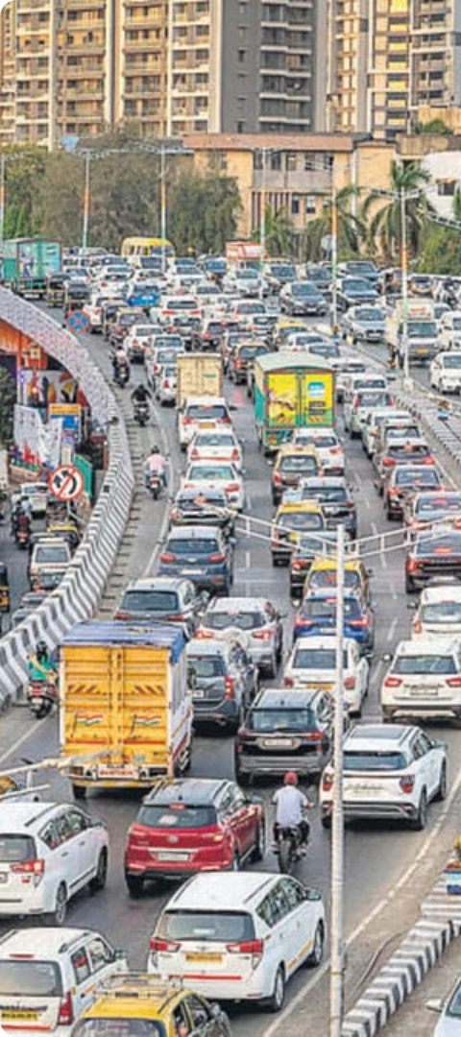
Declining Fatalities, Ongoing Challenges
1
Steady Progress
Mumbai has reported a 43% reduction in road crash deaths since 2015, demonstrating the city's commitment to improving road safety. This progress is the result of collaborative efforts between the Mumbai Traffic Control Branch, the Bloomberg Philanthropies Initiative for Global Road Safety, and other key stakeholders.
2
Pandemic Impact
The COVID-19 pandemic and associated mobility restrictions led to a sharp decline in road traffic deaths and injuries in 2020, with a 22% decrease in fatalities and a 41% decrease in injuries compared to 2019.
3
Ongoing Challenges
Despite the positive trends, road crashes continue to claim lives in Mumbai. Vulnerable road users, such as pedestrians, motorcyclists, and cyclists, account for the majority of deaths and injuries, highlighting the need for targeted interventions to protect the most vulnerable.

Slide 3
Vulnerable Road Users at Risk
Pedestrians
Motorcyclists
Cyclists
Pedestrians accounted for 42% of all road traffic deaths in Mumbai in 2020, highlighting the urgent need for improved infrastructure and safety measures to protect this vulnerable group.
Motorcyclists, including both drivers and passengers, made up 49% of road traffic fatalities, underscoring the importance of helmet use and other safety interventions for this road user group.
Cyclists accounted for 2% of road traffic deaths, emphasizing the need for dedicated cycling infrastructure and awareness campaigns to improve safety for this mode of transportation.

Slide 4
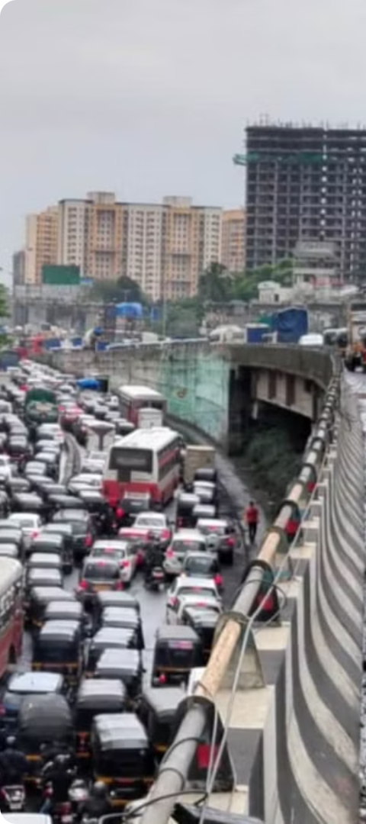
Demographic Patterns in Crashes
1
Gender Disparity
2
Age Vulnerability
Men accounted for 87% of road traffic deaths and 79% of non-fatal injuries, highlighting the need to understand and address the underlying factors contributing to this gender gap.
Young men aged 20-34 years made up the highest number of road traffic fatalities, as well as the majority of motorcycle-related deaths, underscoring the importance of targeted interventions for this high-risk group.
3
Elderly Pedestrians
Older adults, particularly those over 60 years of age, had the highest pedestrian fatality rates, emphasizing the need for infrastructure and safety measures that prioritize the needs of this vulnerable population.

Slide 5
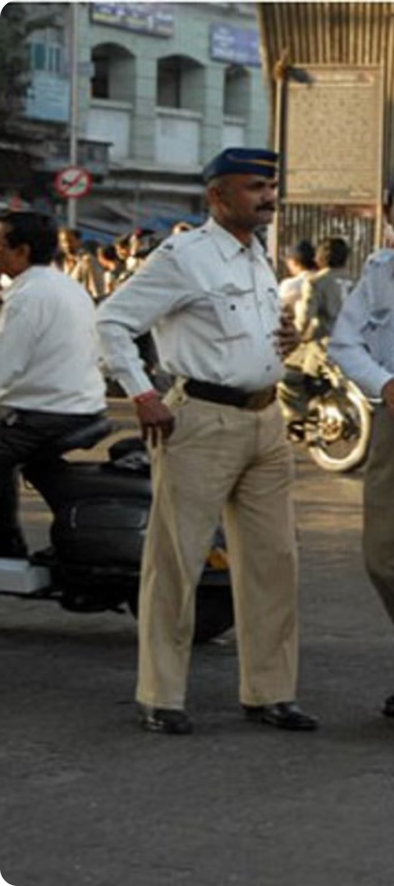
Risky Behaviors and Crash Patterns
Drink-Driving
Traffic Violations
While drink-driving related fatalities and injuries have decreased over the past six years, this dangerous behavior continues to contribute to a significant number of crashes, highlighting the need for sustained enforcement and public awareness campaigns.
Speeding, improper lane usage, and other traffic code violations were associated with a majority of fatal and non-fatal crashes, underscoring the importance of effective enforcement and education to promote compliance with traffic laws.
Temporal Patterns
The peak periods for fatal crashes on weekdays were 16:00 - 17:00 and 20:00 - 22:00, indicating the need for targeted enforcement and public awareness efforts during these high-risk times.

Slide 6
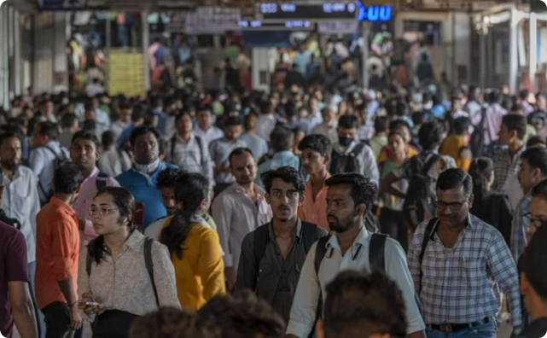
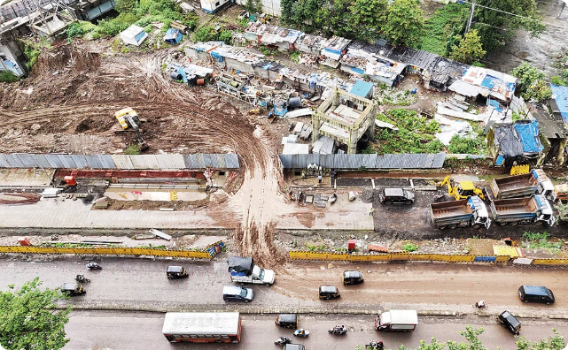
High-Risk Corridors and Junctions
Dangerous Corridors
Hazardous Intersections
The Ghatkopar-Mahul Road, Ghatkopar Flyover, and Asha Nagar Road were identified as the corridors with the highest rates of road crash deaths and serious injuries per kilometer, highlighting the need for targeted infrastructure improvements and safety interventions along these high-risk routes.
The Amar Mahal junction, Godrej junction, and the intersection of the Eastern Express Highway and Jogeshwari-Vikhroli Link Road were found to be the most dangerous junctions in Mumbai, with the highest numbers of fatal and serious injury crashes, requiring comprehensive safety assessments and redesigns.

Slide 7



Spatial Patterns of Crashes
North Mumbai
East Mumbai
West Mumbai
The northern region of Mumbai experienced a high concentration of fatal and injury crashes, with vulnerable road users such as pedestrians and motorcyclists being the most affected.
The eastern region of Mumbai also saw a significant number of crashes, with pedestrians and motorcyclists being the predominant victims, highlighting the need for targeted interventions in these areas.
The western region of Mumbai had a relatively lower density of crashes compared to the north and east, but still experienced a considerable number of incidents involving vulnerable road users.

Slide 8
Assessing the Current State of Congestion
An in-depth analysis of the road congestion in Greater Mumbai reveals several key factors contributing to the problem. The city's rapidly growing population, coupled with a limited and aging road infrastructure, has led to a significant imbalance between travel demand and supply. This mismatch has resulted in longer commute times, increased pollution levels, and higher levels of stress among residents.
Additionally, the city's public transport system, while extensive, struggles to meet the growing demand, leading many commuters to rely on private vehicles. This shift towards personal modes of transportation has further exacerbated the congestion, creating a vicious cycle that needs to be addressed.

Slide 9
Short-Term Interventions
1
Optimize Traffic Signals
2
Expand Bus Rapid Transit
Implement a smart traffic signal system that can adapt to real-time traffic conditions, improving the flow of vehicles and reducing stop-and-go traffic.
Accelerate the implementation of dedicated bus lanes and prioritize public transport, making it a more attractive and efficient option for commuters.
3
Promote Carpooling and Ride-Sharing
4
Improve Pedestrian and Cycling Infrastructure
Encourage the use of carpooling and ride-sharing platforms through incentives and awareness campaigns, reducing the number of single-occupancy vehicles on the roads.
Invest in safer and more accessible pedestrian walkways and cycling lanes to promote non-motorized modes of transportation.

Slide 10
Short-Term Solutions
To provide immediate relief, MCGM should consider implementing the following short-term measures:
1
Traffic Signal Optimization
2
Improved Public Transportation
Optimizing the timing and coordination of traffic signals can help improve the flow of vehicles, reducing congestion and idling times.
Enhancing the reliability, frequency, and coverage of public transportation options, such as buses and trains, can encourage more residents to use them, thereby reducing the number of private vehicles on the roads.
3
Parking Management
4
Awareness Campaigns
Implementing a comprehensive parking management system, including dynamic pricing and designated parking zones, can discourage unnecessary driving and encourage the use of alternative transportation modes.
Launching public awareness campaigns to educate residents on the benefits of sustainable transportation choices and the negative impacts of private vehicle usage can help shift mindsets and behaviors.

Slide 11



Embracing Innovation
Dynamic Congestion Pricing
Mobility as a Service (MaaS)
Autonomous and Connected Vehicles
Implement a flexible, real-time pricing system that adjusts charges based on traffic conditions, incentivizing the use of alternative modes of transportation during peak hours.
Develop a comprehensive MaaS platform that integrates various transportation options, allowing users to plan, book, and pay for their journeys through a single, seamless interface.
Prepare for the future integration of autonomous and connected vehicles, which can lead to improved traffic management, reduced accidents, and more efficient use of road infrastructure.

Slide 12
Long-Term Strategies
Integrated Transport Planning
Dynamic Congestion Pricing
Enhancing Public Transport
Adopt a holistic, integrated approach to transportation planning, ensuring coordination between various modes of transport, land use, and urban development. This will help create a seamless, multimodal system that caters to the diverse needs of commuters.
Implement a dynamic congestion pricing system that charges variable fees based on the level of traffic, incentivizing the use of public transport and discouraging private vehicle usage during peak hours.
Invest in the expansion and modernization of the public transport network, including the development of new metro lines, suburban rail systems, and improved bus services. This will provide commuters with reliable and efficient alternatives to private vehicles.

Slide 13
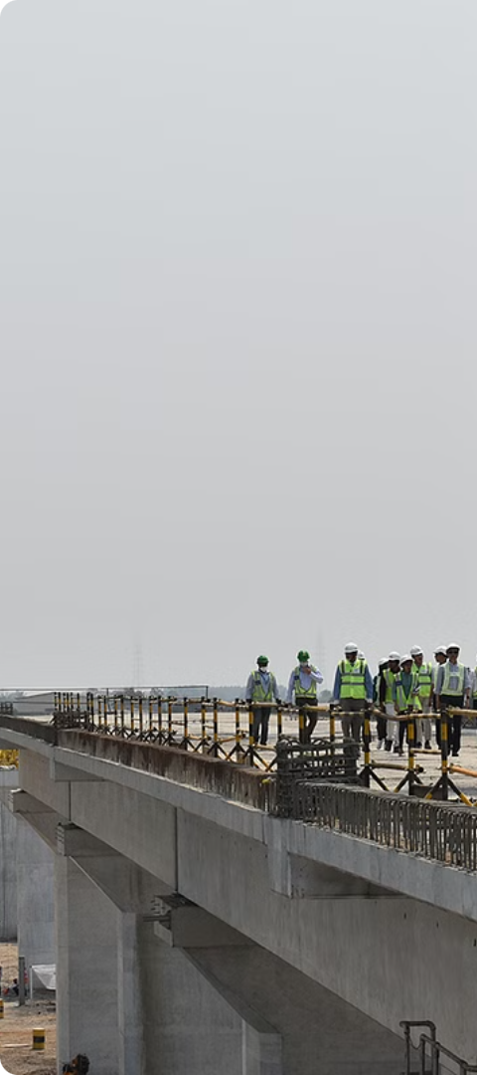
Long-Term Strategies
To ensure sustainable improvement in traffic flow and urban mobility, MCGM should consider the following long-term strategies:
1
Infrastructure Upgrades
Investing in the expansion and enhancement of road infrastructure, including the construction of flyovers, elevated corridors, and dedicated lanes for public transportation, can significantly improve traffic flow and reduce congestion.
2
Multimodal Integration
Developing a comprehensive multimodal transportation system that seamlessly integrates various modes, such as buses, trains, metro, and non-motorized options like bicycles and pedestrian walkways, can provide residents with a convenient and efficient travel network.
3
Intelligent Transportation Systems
Implementing Intelligent Transportation Systems (ITS), including advanced traffic management systems, real-time traffic monitoring, and smart signaling, can optimize the flow of vehicles and provide commuters with real-time information to plan their journeys effectively.

Slide 14




Promoting Sustainable Mobility
Electric Vehicles
Shared Mobility
Smart City Initiatives
Active Transportation
Encourage the adoption of electric vehicles through incentives, charging infrastructure, and regulations to reduce emissions and noise pollution.
Support the growth of shared mobility options, such as bike-sharing and scooter-sharing programs, to provide first-and-last-mile connectivity and reduce private vehicle usage.
Leverage smart city technologies, including real-time traffic monitoring and intelligent transportation systems, to optimize traffic flow and provide commuters with better information and route planning.
Invest in walking and cycling infrastructure to promote active modes of transportation, improving public health, reducing emissions, and enhancing the overall livability of the city.

Slide 15
Phased Implementation
To ensure the effective and efficient implementation of the proposed solutions, MCGM should adopt a phased approach:
Phase
Timeline
Key Initiatives
Short-Term
0-2 years
Traffic signal optimization, public transportation improvements, parking management, and awareness campaigns
Medium-Term
2-5 years
Infrastructure upgrades, multimodal integration, and the deployment of Intelligent Transportation Systems
Long-Term
5-10 years
Transit-oriented development, pedestrian and bicycle infrastructure, and comprehensive urban planning initiatives
By adopting a phased approach, MCGM can ensure that the immediate needs are addressed while simultaneously laying the foundation for long-term sustainable solutions, ultimately transforming the transportation landscape of Greater Mumbai.

Slide 16



Monitoring and Evaluation
To ensure the long-term success of the transportation initiatives, MCGM should establish a robust monitoring and evaluation framework:
Data Collection
Performance Evaluation
Continuous Improvement
Implementing comprehensive data collection systems, including traffic sensors, travel surveys, and performance indicators, will provide the necessary information to track the effectiveness of the implemented solutions and inform future decision-making.
Regularly evaluating the performance of the transportation initiatives against key metrics, such as travel times, congestion levels, air quality, and user satisfaction, will enable MCGM to assess the impact of the interventions and make necessary adjustments.
Continuously analyzing the data, evaluating the performance, and incorporating feedback from stakeholders will allow MCGM to refine and enhance the transportation strategies, ensuring that they remain effective and responsive to the changing needs of the city.

Slide 17




Funding and Financing Strategies
Implementing the proposed solutions will require substantial financial resources. MCGM should explore the following funding and financing strategies:
Government Funding
Public-Private Partnerships
Revenue-Generating Measures
Innovative Financing
Securing funding from the central and state governments, as well as international development agencies, can provide the necessary resources to finance infrastructure upgrades, public transportation improvements, and other transportation-related initiatives.
Exploring public-private partnership (PPP) models can leverage private sector expertise, resources, and investment to supplement government funding and enable the implementation of large-scale transportation projects.
Exploring innovative financing mechanisms, including green bonds, infrastructure funds, and crowdfunding platforms, can diversify the funding sources and attract additional investment for the transportation initiatives.
Implementing revenue-generating measures, such as congestion pricing, parking fees, and fuel taxes, can provide a sustainable source of funding for ongoing maintenance and operations, as well as future transportation improvements.

Slide 18
Urban Planning Initiatives
To support the long-term transportation strategies, MCGM should also focus on comprehensive urban planning initiatives that promote sustainable development and reduce the need for private vehicle usage:
Transit-Oriented Development
Pedestrian and Bicycle Infrastructure
Green Spaces and Urban Greening
Encouraging the development of mixed-use, high-density neighborhoods centered around public transportation hubs can reduce the reliance on private vehicles and promote walkable, livable communities.
Investing in the creation of dedicated pedestrian walkways, bike lanes, and other non-motorized infrastructure can enhance the safety and accessibility of these sustainable transportation modes, encouraging their adoption among residents.
Integrating green spaces, parks, and urban greening initiatives within the transportation network can not only improve the aesthetic appeal of the city but also contribute to better air quality and a more livable environment for residents.

Slide 19
Potential Benefits
Reduced Travel Times
Improved commute times and reduced congestion will allow residents to spend less time on the road and more time on other activities.
Lower Emissions
The shift towards sustainable modes of transportation and reduced private vehicle usage will lead to a significant decrease in greenhouse gas emissions and air pollution, improving the city's environmental quality.
Economic Benefits
A more efficient transportation system will facilitate the smooth movement of goods and services, leading to increased productivity, reduced costs, and a boost in economic activity.
Enhanced Quality of Life
Reduced congestion, improved air quality, and better access to transportation options will contribute to a higher quality of life for residents, leading to improved health, well-being, and overall satisfaction.

Slide 20
Stakeholder Engagement and Collaboration
Addressing the road congestion challenge in Greater Mumbai will require a collaborative effort involving various stakeholders:
Residents and Commuters
Private Sector Partners
Engaging with residents and commuters to gather feedback, understand their needs, and incorporate their perspectives into the transportation planning process is crucial for ensuring that the solutions are tailored to the community's requirements.
Collaborating with private sector entities, such as real estate developers, businesses, and technology companies, can unlock innovative solutions, funding opportunities, and public-private partnerships that can enhance the effectiveness of the transportation initiatives.
Government Agencies
Research and Academic Institutions
Coordinating with other government agencies, including the state government, urban development authorities, and transportation departments, can help align policies, secure funding, and ensure a cohesive and integrated approach to addressing the congestion problem.
Engaging with research and academic institutions can provide access to cutting-edge research, expertise, and best practices in transportation planning and urban mobility, which can inform the development of effective and evidence-based solutions.

Slide 21
Risks and Mitigation Strategies
Equity Concerns
Ensure that the proposed interventions, such as congestion pricing, do not disproportionately burden low-income communities and that access to affordable transportation options is maintained.
Funding and Implementation
Secure adequate funding and develop a clear implementation plan to ensure the timely and effective delivery of the proposed interventions, minimizing disruptions to the city's operations.
1
2
3
Public Acceptance
Engage with the public, businesses, and other stakeholders to address their concerns, build trust, and gain support for the proposed changes to the transportation system.

Slide 22
Building Public Support through Engagement and Education
Public Awareness Campaigns
Stakeholder Engagement
Collaborative Partnerships
Educating the public on the benefits of proposed transportation changes is crucial for garnering support. Leverage media, workshops, and community meetings to highlight how initiatives like congestion pricing, road space reallocation, and increased public transit use can improve livability, reduce emissions, and enhance overall mobility.
Involve community leaders, neighborhood representatives, and diverse stakeholders in the planning and decision-making processes. This inclusive approach helps address concerns, incorporate local insights, and ensure that the needs of all community members are taken into account.
Foster strong partnerships with local businesses, non-profit organizations, and advocacy groups. These collaborations can amplify outreach efforts, facilitate knowledge sharing, and mobilize broader support for transportation initiatives.

Slide 23
Overcoming Financial Barriers through Strategic Funding
1
Public-Private Partnerships (PPPs)
2
Government Grants and Loans
3
Innovative Financing Mechanisms
Leverage private sector investment and expertise through innovative PPP models, which can provide the necessary funding and technical capabilities to implement large-scale infrastructure projects and technology solutions.
Actively seek grants and low-interest loans from national, state, and international sources to supplement local budgets and finance sustainable transportation initiatives.
Explore creative financing options, such as congestion pricing revenue, value capture strategies, and green bonds, to unlock additional funding streams for transportation improvements.

Slide 24

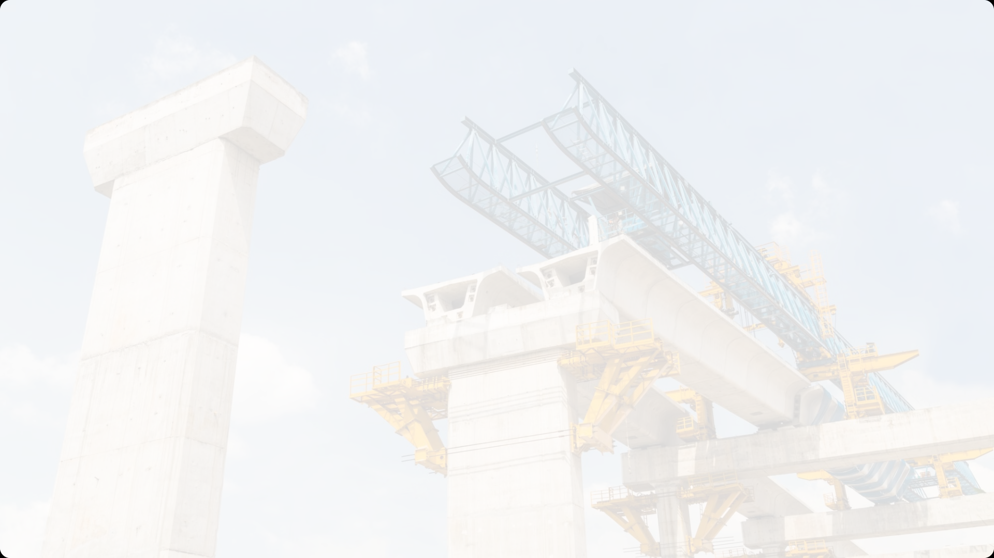

Ensuring Smooth Implementation and Equitable Outcomes
Robust Project Management
1
Employ experienced project managers and leverage proven project management frameworks to oversee the implementation of transportation initiatives. Regular monitoring and prompt issue resolution are crucial to keep projects on track and address any technical challenges.
2
Contractor Selection
Carefully vet and select reliable contractors with a proven track record in technology and infrastructure projects. This helps mitigate the risks of poor construction quality and delays.
Inclusive Planning and Accessibility
3
Ensure that transportation planning considers the needs of all demographic groups, including marginalized communities. Implement universal design standards and provide subsidies or incentives to ensure equitable access to transportation improvements.

Slide 25



Navigating the Regulatory Landscape and Safeguarding Digital Assets
Policy Advocacy and Compliance
Data Privacy and Security
Resilience and Contingency Planning
Work closely with policymakers to create a supportive regulatory environment for transportation initiatives. Engage legal experts to navigate complex regulations and ensure full compliance.
Develop and enforce robust data privacy policies to protect personal information. Implement advanced cybersecurity measures to safeguard transportation data and systems against breaches.
Design resilient infrastructure that can withstand natural disasters and other external shocks. Develop contingency plans to ensure quick and effective responses to unforeseen events.

Slide 26
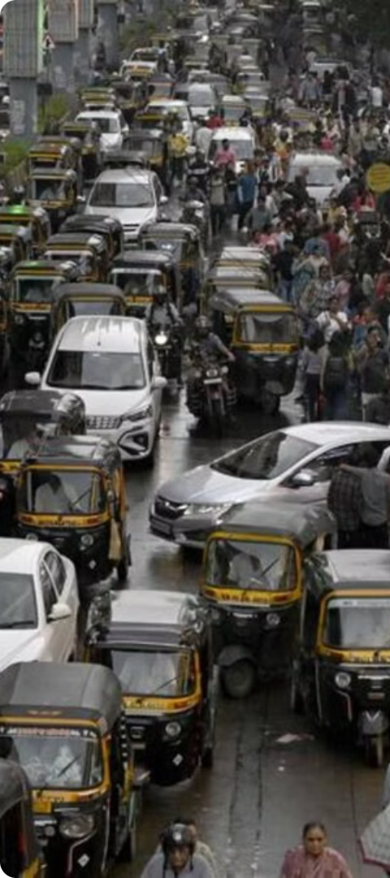



Toward a Safer Mumbai
Data-Driven Approach
The comprehensive data and analysis presented in this report provide a solid foundation for evidence-based decision-making and the implementation of targeted interventions to improve road safety in Mumbai.
Collaborative Efforts
The ongoing partnership between the Mumbai Traffic Control Branch and the Bloomberg Philanthropies Initiative for Global Road Safety underscores the importance of multi-stakeholder collaboration in addressing the complex challenge of road safety.
Continued Commitment
Mumbai's steady progress in reducing road traffic deaths and injuries over the past six years demonstrates the city's unwavering commitment to creating a safer transportation system for all road users, a commitment that must be sustained and strengthened in the years to come.

Slide 27
A Vision for Zero
Vulnerable Road Users
Targeted Infrastructure
Enforcement and Education
Collaborative Approach
Prioritize the safety of pedestrians, motorcyclists, and cyclists through dedicated infrastructure and safety measures.
Implement road design improvements, such as pedestrian crossings, traffic calming measures, and dedicated cycling lanes, to create a safer environment for all road users.
Strengthen enforcement of traffic laws and promote public awareness campaigns to address risky behaviors like speeding, drink-driving, and non-use of helmets and seatbelts.
Foster continued collaboration between government agencies, civil society, and international partners to develop and implement comprehensive road safety strategies for Mumbai.

Slide 28
Conclusion
The road congestion challenge in Greater Mumbai requires a comprehensive and strategic approach to address the pressing issues and ensure a more efficient, accessible, and environmentally friendly transportation system. This report has outlined a detailed plan of action, including short-term solutions and long-term strategies, to tackle the problem. By implementing these recommendations and fostering collaboration among various stakeholders, MCGM can create a more livable and economically vibrant city for its residents. The successful execution of this plan will not only improve the quality of life for the citizens but also contribute to the overall development and growth of Greater Mumbai.

Slide 29
Reference
Mumbai Traffic Police website(for traffic and accident data both)
TomTom traffic index
MSRDC website
Brihanmumbai electric supply and transport
MMRDA
Indian railways
MPCB(for pollution data)
NCRB(for road accidents and such)
Smart City mission(for innovative solutions campaign)
NIUA(urban mobility and smart City tech)

